Slide 1
Ukraine C-IED Project
Online Studio 3 Group 3
Valérie Lavigne, valelavi@gmail.com
Marius Panga, marius.c.panga@gmail.com
Jayaram Shivas Vadakumpuram, shivasj@gmail.com

Slide 2
Goals
Is there a temporal pattern in the number of IED incidents?
Where are the IED incidents located within Ukraine?
How do the incidents relate to the conflict in Eastern Ukraine? Is there a relation between he number of incidents and the distance to the conflict zone and the political situation?
Do the ratios of incidents remain stable over time between the different regions? Do the incidents seem to move from one region to another?
How does the rate of IED incidents relate to the total number of reported casualties and injuries?
Do the different types of IEDs have interesting geo-temporal patterns?
Is the number of incidents correlated with regional census data.
Can we correlate any spikes or patterns in the data with political developments in the conflict (Crimea Annexation, agreed Ceasefire, Ukraine elections …)
Is there any additional insight that can be obtained from the free-text incident description field in the main data source?

Slide 3
Tasks
Data analysis:
go over all the candidate data sources and selecting the bits of data that will be relevant to the project
Data gathering:
while our main data source is already in a structured format, the additional sources are not(news articles, PDF files, images). This step involves getting all the relevant data into a structured format (txt or cvs files)
Data cleaning:
make sure the data that has been identified as relevant is in a consistent format. Standardize the handling of incorrect or missing data, as well as any formatting issues
Data filtering:
based on the data analysis outcome, remove any data that is needed for the visualization
Data model design:
identify the JavaScript entities that will contain / reference the source data

Slide 4
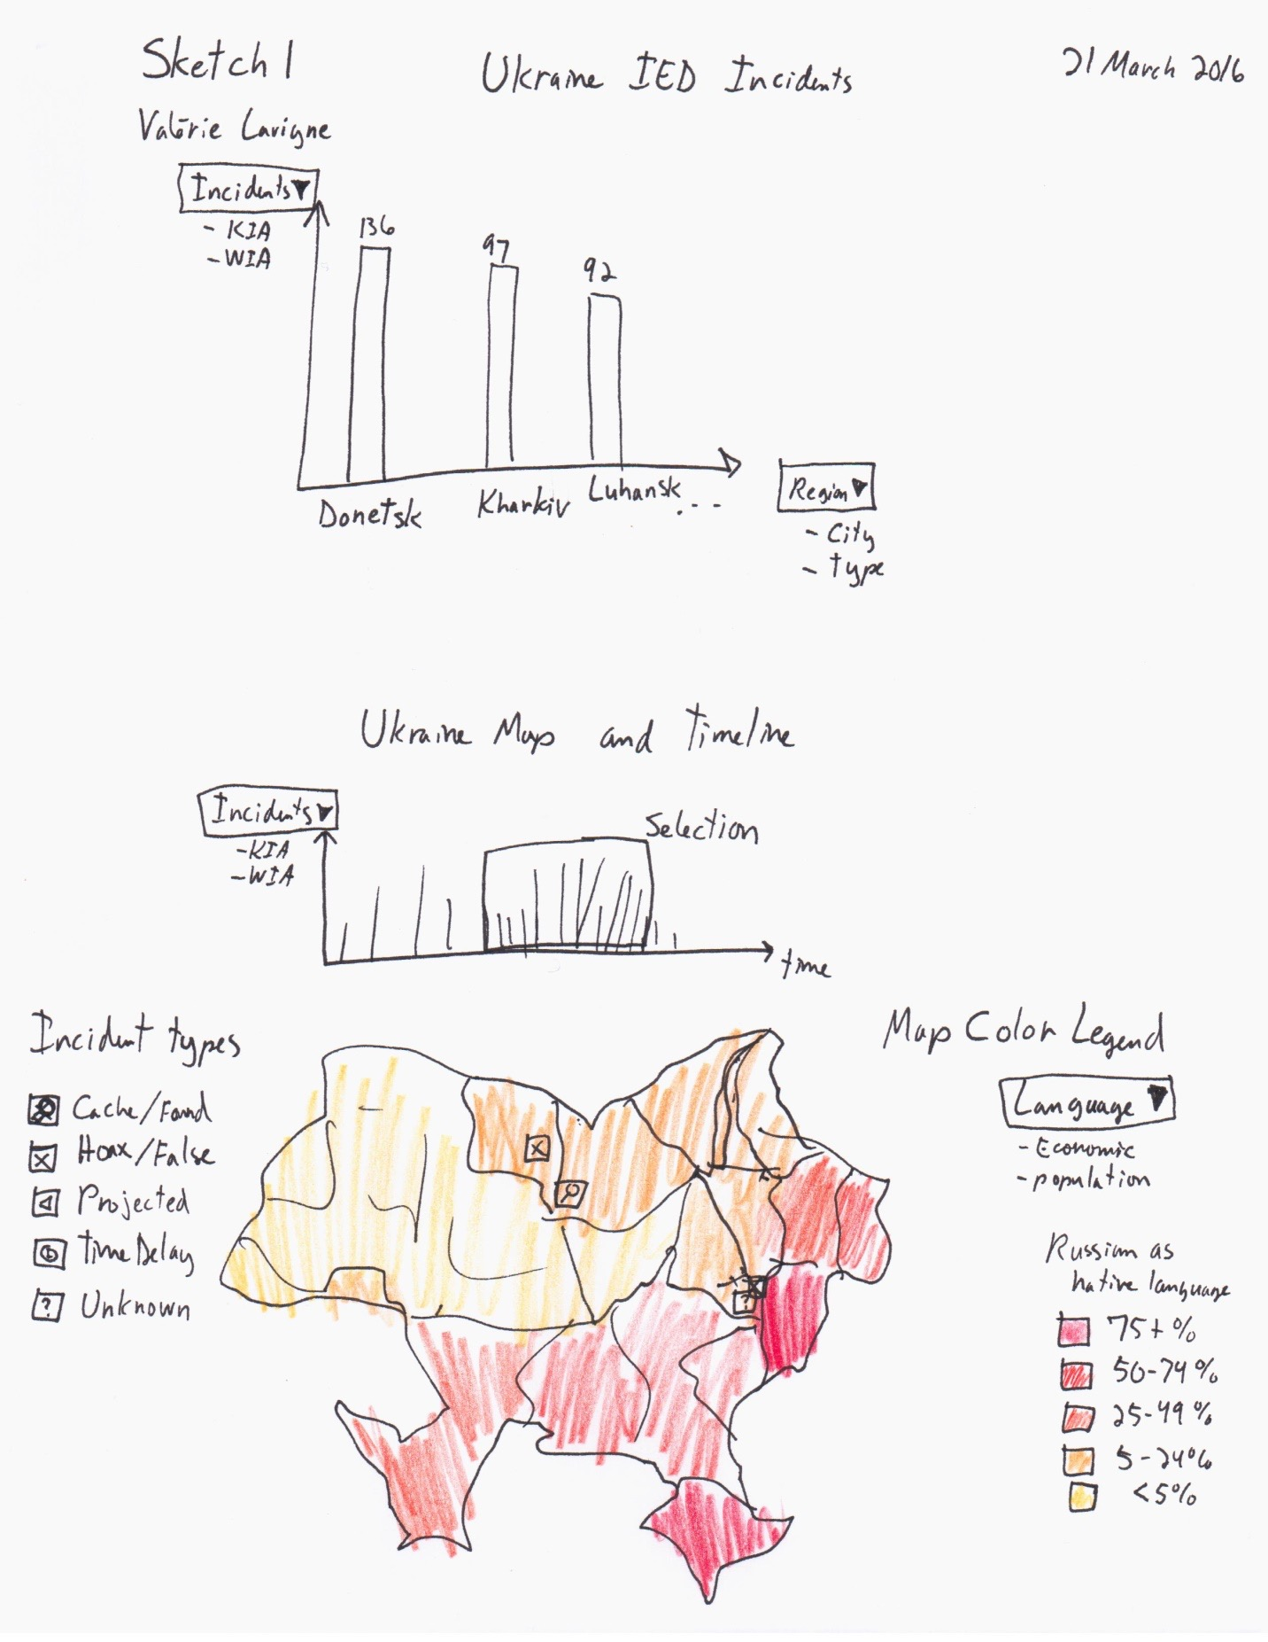
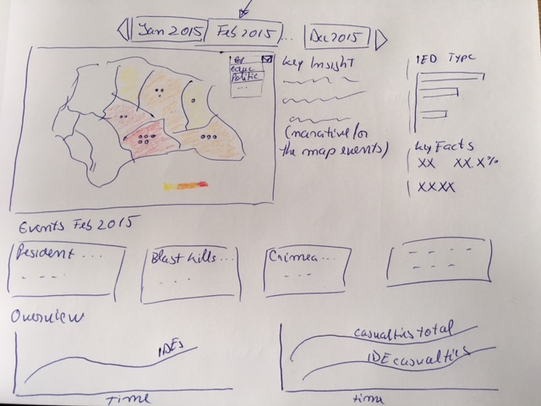
Sketches

Slide 5
Data
Ukraine IED Incidents Data
Ukraine Map Data – geojson/topojson
Ukraine Census Data
Ukraine 2010 Presidential Elections Data
Ukraine Conflict Timeline
Ukraine Conflict Causalities and Injuries Data

